Slide 1

Robust Simulation Agents for Review Platforms
A Decoupled Neuro-Symbolic Approach
Jack He
Zihan Jiang
Alice Jung
December 2, 2025

Slide 2

Introduction - Overview
Web Society Simulator - User Behavior Simulation Track
Focus on understanding user preferences and simulating online reviews
Design agents to simulate user reviews and star rating
Simulate user behavior in specific scenarios by leveraging their historical actions and accessible environmental data

Slide 3
Introduction - Current Problem
Current LLM-based agents often struggle to maintain consistency between a user’s historical rating distribution and their generated text
Models frequently prioritize linguistic fluency over statistical accuracy
It results in plausible-sounding reviews that fail to reflect the user’s actual ground-truth biases.

Slide 4
Introduction - Motivation
The rating scale is narrow(1-5), so ratings for the same user and item typically do not vary much
Instead of generating ratings from scratch by LLMs, we use historical ratings as a more reliable prior
The LLMs focuses on generating a review consistent with the given rating
This approach helps reduce hallucinations by applying deterministic constraints on rating generation

Slide 5
Introduction - Idea & Goal
Idea
Compare two approaches:
LLM-generated rating + review (Baseline)
Historical rating + LLM-generated review
Goal
Evaluate whether historical ratings provide a stronger, more stable ratings than LLM-generated ratings
Analyze differences in consistency and stability between the two approaches
Determine whether historical data improves the quality of generated reviews

Slide 6
2. Method/System Design

Slide 7
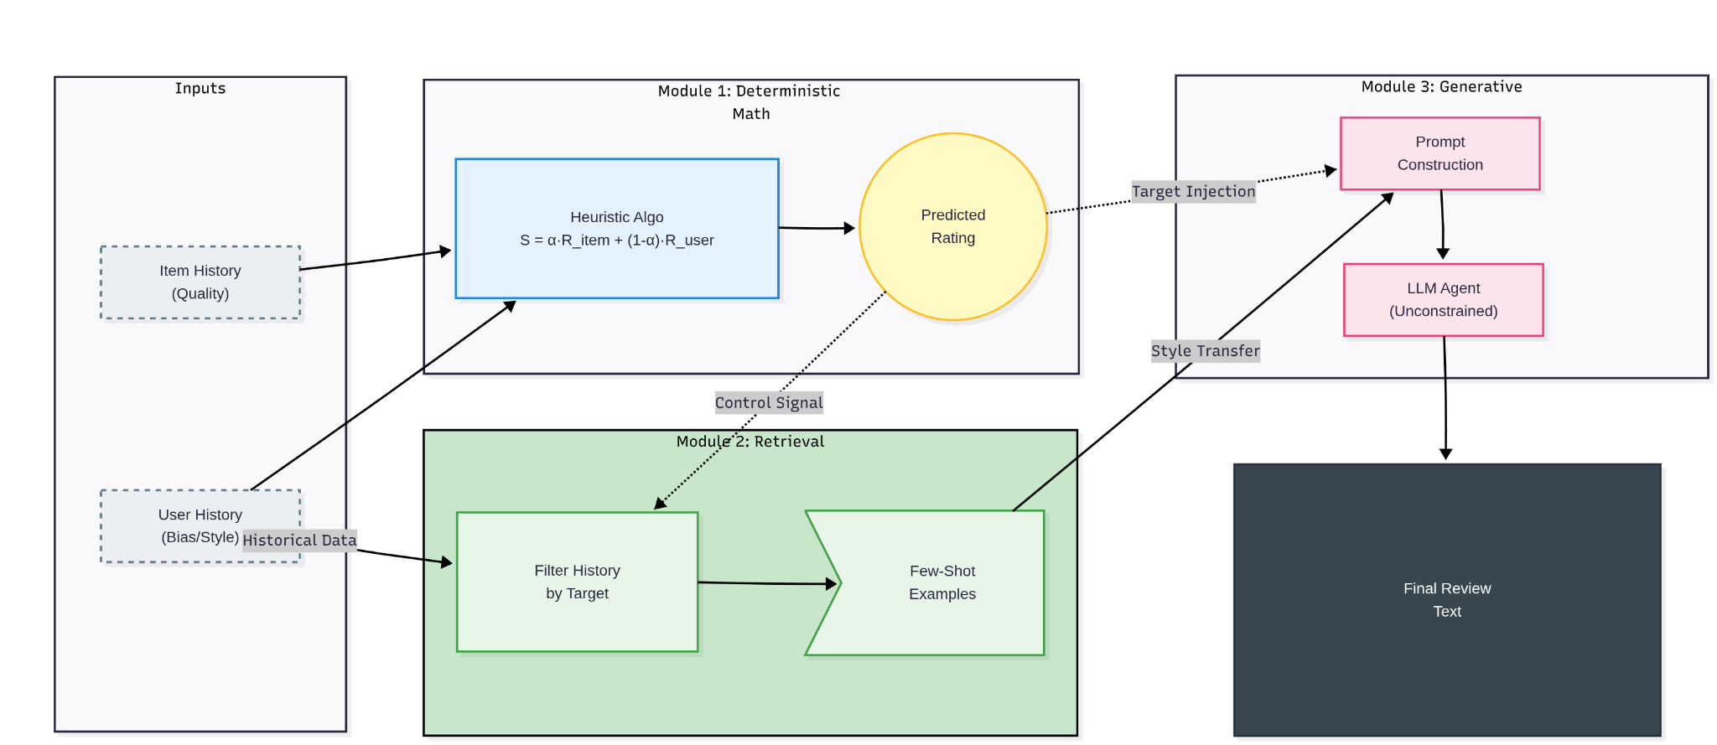
Hybrid Neuro-Symbolic SImulation

Slide 8



Module1: Deterministic Rating Prediction
Purpose
To prevent rating hallucinations
Predict star rating based on historical data
Method
A weighted averaging algorithm
Prioritize the item’s reputation
Ensures that agent never output a 1-star rating for a high acclaimed business simply due to stochastic noise

Slide 9
Module2: Target-Conditioned Context Retrieval
Purpose
To prevent “Hallucination of Sentiment” problem
Method
Retrieve only past reviews where the user gave the same star rating
Create a few-shot prompt that corresponds to the target output

Slide 10
Module3: Guided Generative Reasoning
Purpose
To prevent the artificial truncation of reasoning chains
Method
GuidedReasoning module
Remove constraints on temperature and max_tokens
Enables linguistic diversity characteristic of real human users
stylistically aligned few-shot example provide contextual guidance.

Slide 11
3. Experiment Analysis

Slide 12
Evaluation Setup and Ablation Strategy
Datasets: Yelp, Amazon, Goodreads
Metrics: - preference_estimation - review_generation - overall_quality
Ablation Plan: We evaluate 5 factors: 1. Heuristic rating weight α 2. Base LLM size/type (inverse scaling) 3. Prompt structure (generic vs domain-aware) 4. Cross-domain user augmentation 5. LLM-Assisted Rating

Slide 13
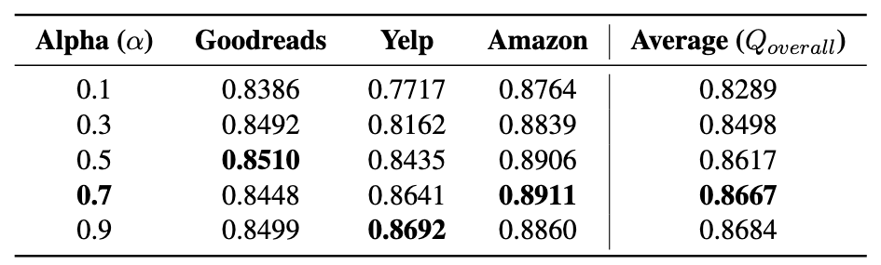
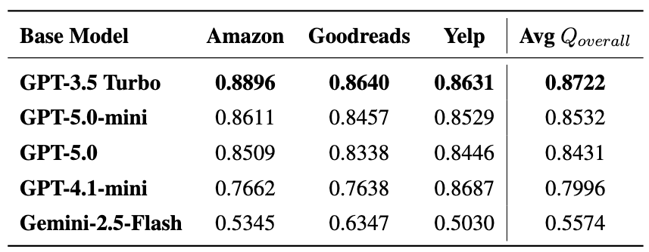
Experiments
Experiment 1 - Rating Weight α (Successful → Included in Final Pipeline) Goal: find the optimal balance between item quality and user history
Experiment 2 - Base LLM Model (Successful → Included in Final Pipeline) Goal: test the dependency on model scale and architecture

Slide 14
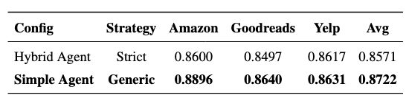
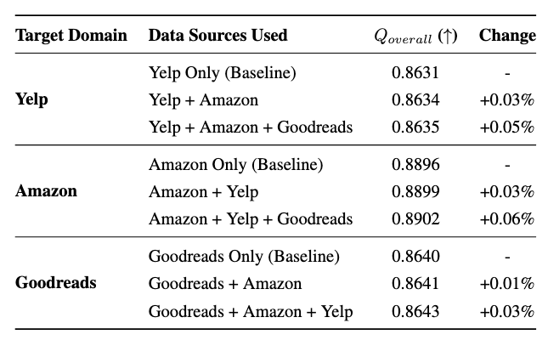
Experiments
Experiment 3 - Domain-Aware Prompting (Failed → Not in Final Pipeline) Goal: test whether domain-specific review structure (e.g., food, service, plot, characters) helps with more realistic, context-aware reviews
Experiment 4 - Cross-Domain User Augmentation (Failed → Not in Final Pipeline) Goal: investigated whether augmenting user profiles with data from other platforms (e.g., adding Amazon purchase history to a Yelp user) improved performance

Slide 15
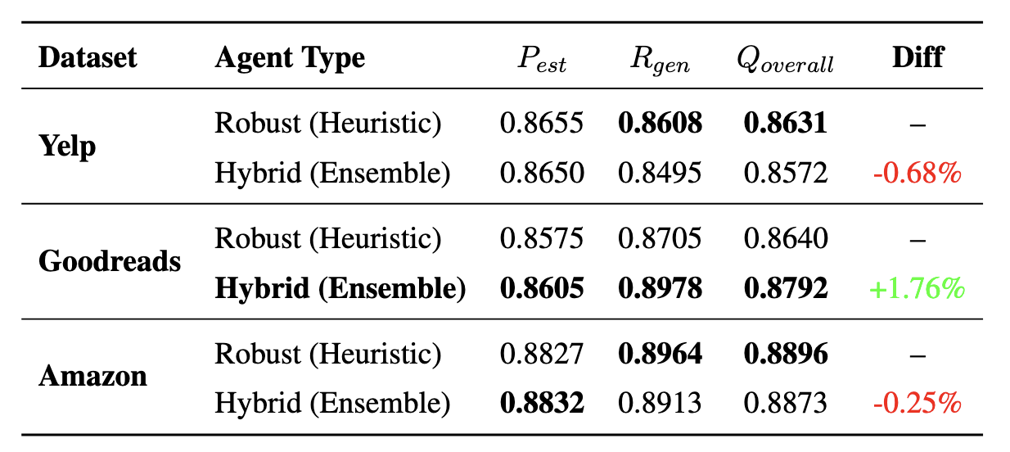
Experiments
Experiment 5 - LLM-Assisted Rating Goal: test whether adding LLM to star prediction improves the performance

Slide 16
4. Limitations and Future Work

Slide 17
Limitations and Future Work
Limitation: No user history → cannot condition ratings or style
Future Work: Cold-start user modeling

Slide 18
5. Conclusion

Slide 19
Conclusion
Historical ratings provide more stable and consistent Predictions than LLM-generated ratings
Hybrid architecture improves review quality by conditioning LLM on historical examples
Decoupling rating prediction resolves sentiment hallucination and boosts stylistic fidelity

